Slide 1

Software Development & Best Practices
This Photo by Unknown Author is licensed under CC BY-NC
Lecture 13 – Putting it all together!

Slide 2
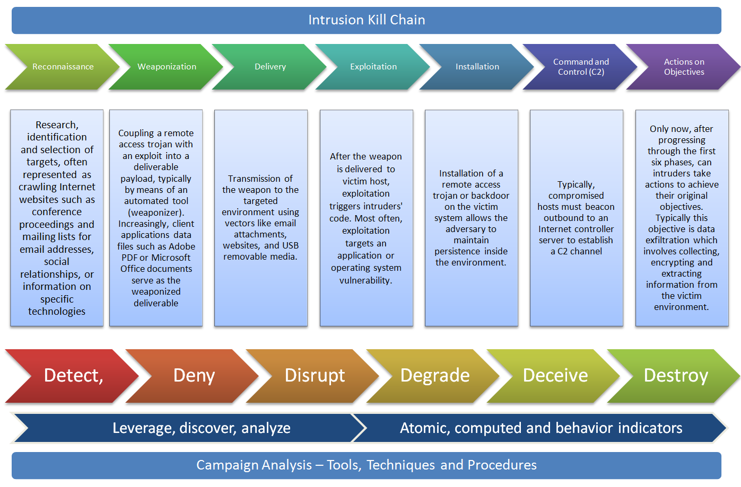
How do I attack a system?
Hacking is sometimes considered more art than science but as we’ve pointed out in this course. There are definitely some places that are better to start out than others.
In this course we will be using a rather simplified version of the Cyber Kill Chain.
The CKC was developed by Lockheed Martin -- a developer of military equipment . It breaks down penetration testing into seven categories.
This Photo by Unknown Author is licensed under CC BY

Slide 3
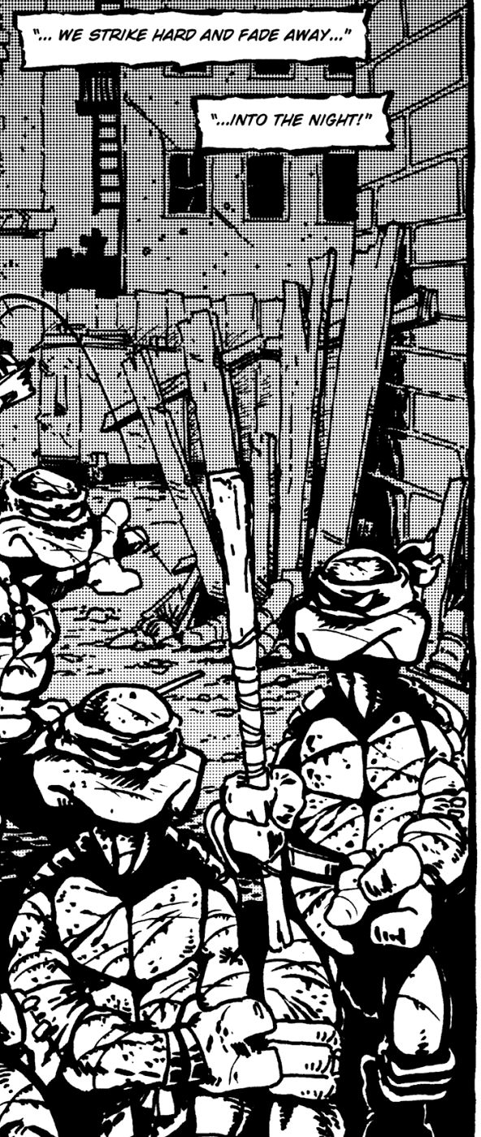
Reconnaissance
Probably the thing we talked about the most in this course. It can encompass a wide variety of activities.
Passive Recon – Usually the first step in any hack. Involves finding information without actually talking to their computers.. This can include…
Getting publicly available literature. Advertisements, technical manuals.
Talking to people on the phone – social engineering.
Talking to other computers such as doing DNS footprinting.

Slide 4
Reconnaissance
Active Recon. (probing) – This is often the next step. You will interact with their computers and documenting responses, but you will avoid any kind of highly crafted HTTP request.
Why?
Other active recon systems can be port scanning, OS Fingerprinting, application profiling.

Slide 5

Reconnaissance
Some tools you can use:
Nmap – Used for port scanning/fingerprinting but is besed used when your IP is hidden (or when you’re just practicing),
What’s that site running. This is a web page which has likely already determined the application version and OS version of the site you are thinking of attacking. https://sitereport.netcraft.com/
You should probably still use Tor to hide your identity
It won’t work on internal networks
Examing HTTP headers. A lightly active recon method. Many applications, load balancers and other hardware advertise themselves in hidden HTTP headers. For example you can sometimes determine the version of PHP from these when you see::
X-Powered-By - PHP/7.3.19-1~deb10u1
This Photo by Unknown Author is licensed under CC BY

Slide 6
Reconnaissance
When examining the application directly. Always be aware of the URLs/paths. They frequently tell you something about the internal structure of the machine and/or network.
For example, what does the following URL tell you about the filesystem?

Slide 7

Reconnaissance
Always examine the HTML of the application carefully.
URLs tell you something about the document or filesystem structure?
Look for form fields.
Look for cookies being set.
Look for any information about the programming languages or frameworks being used.
This Photo by Unknown Author is licensed under CC BY

Slide 8
Reconnaissance
Other questions!
Is packaged software being used? (i.e. wordpress)
What are the known flaws?
https://cve.mitre.org/
Is there information about higher privileged accounts?
Does any part of the website let you know other peoples account names? Can you derive them from their email addresses?
This Photo by Unknown Author is licensed under CC BY

Slide 9
Reconnaissance
When you start doing active recon. Make sure you send information to their servers in the most innocent way possible.
Find hidden documents – attempt non standard URLs (but use standard names like admin.php.
If that doesn’t work, there are tools for finding hidden URLs/directories. Like DirBuster in Kali Linux.
This Photo by Unknown Author is licensed under CC BY

Slide 10
Reconnaissance
Get a login:
Find out what information is posted?
Find out what information is in the response
Getting access to internal email or messaging systems. Is a great way to get information that isn’t available to the public.
Sometimes even finding out that lots of people from your target hang out on specific Facebook or Reddit groups.
This Photo by Unknown Author is licensed under CC BY

Slide 11
Reconnaissance
When examining an HTML form make a note as to what fields are accepted what values can you successfully send?
Keep track of what parameters are accepted by the url?
Make note of any places where you think data is being used to do a SQL query?
Do some fields allow you to filter information?
This Photo by Unknown Author is licensed under CC BY

Slide 12
Reconnaissance
Are there places where data is being used to invoke a shell command?
Directory listings, password changes.
Are there places where data is being executed as code?
Does the website have a sandbox for testing out a programming language or product?
Are there places where data is being used to create content for other users?
Posts
uploads
This Photo by Unknown Author is licensed under CC BY

Slide 13
Reconnaissance
Are there places where session information is being used to maintain authentication?
Keep track of all this information for all of the web pages in the application.
A successful hack is all about keeping good notes!
This Photo by Unknown Author is licensed under CC BY

Slide 14
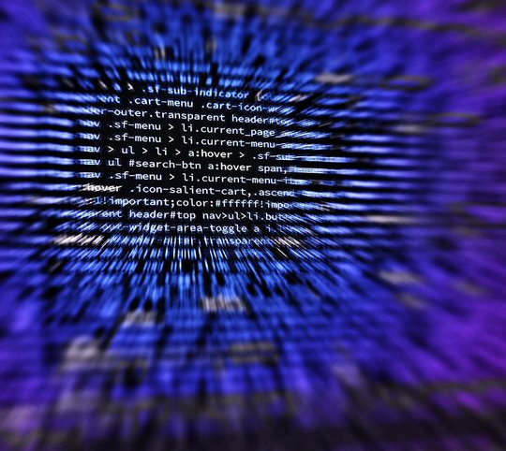
Weaponization Delivery Exploitation
The next three parts of the CKC are:
Weaponization: Creating a technique, exploit or software to penetrate the system.
Delivery: Getting the weaponized system to the target.
Exploitation: Using the weaponized system to get access.

Slide 15
Weaponization Delivery Exploitation
In this course we will look at these three as a single unit.
Here is where you should be asking yourself questions like:
Can we do SQL injection?
Can we do command injection?
Can we do code injection?
Can we do XSS, CSRF
Can we do LFI?

Slide 16
Weaponization Delivery Exploitation
Can we get access to another account?
Can we get access to a higher-level account?
session hijacking
credential stuffing
brute force attack
Can we get access to email or other communications with privileged information?
Can we get access to the operating system?
Remote shell.
Reverse shell

Slide 17

Installation Command & Control Actions
The next three concepts are:
Installation: Getting persistent access. If you use a security flaw to gain access to a system. There’s always a chance that it will get patched. Thinking ahead means making sure there is always another way back in. This could mean creating a flaw of your own or even getting someone to give you an account.
This Photo by Unknown Author is licensed under CC BY-SA

Slide 18
Installation Command & Control Actions
Command & Control: For larger scale attacks you will probably want the ability to make changes on this (and perhaps several other machines) without logging in. For example, machines that are part of a botnet always have a CnC system.
This Photo by Unknown Author is licensed under CC BY-SA

Slide 19
Installation Command & Control Actions
Actions on Objective: At this point you are doing whatever you are trying to accomplish here. Destroy data, shut down the company. Make them participate in a botnet.
This Photo by Unknown Author is licensed under CC BY-SA

Slide 20
Installation Command & Control Actions
In small scale attacks or penetration tests you might never use these steps. However, it’s at this point that it’s useful to ask yourself questions like:
How well have I documented what I did?
How much of it can be undone?
An important part of persistent access. Is making sure people never realize you were there!
This Photo by Unknown Author is licensed under CC BY-SA

Slide 21
Lab 1
In our next class we will be using a pre-made VM.
It will contain a web application and some instructions.
Your job will be to perform and document
Reconnaissance
Exploitation
Your mark on the lab will not only have to do with how far you were able to penetrate the system but how well and how detailed your attack documentation was.
This Photo by Unknown Author is licensed under CC BY-SA

